Slide 1
Evaluating the role of cumulative history in auditory perceptual bistability

Slide 2
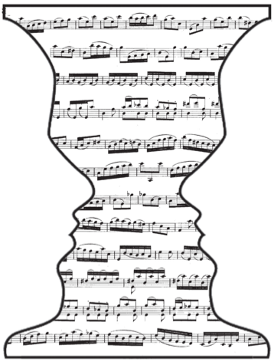
Topic review: The buildup of auditory stream segregation with alternations
Auditory scene analysis
Formation of auditory streams
Competition between perceptual organizations
Alternations for ambiguous stimuli
Pressnitzer, Suied, Shamma (2011)

Slide 3

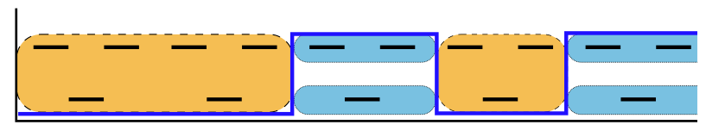
Experimental paradigm
++
time (s)
Daniel Pressnitzer, http://audition.ens.fr/sup/
van Noorden (1975)

Slide 4
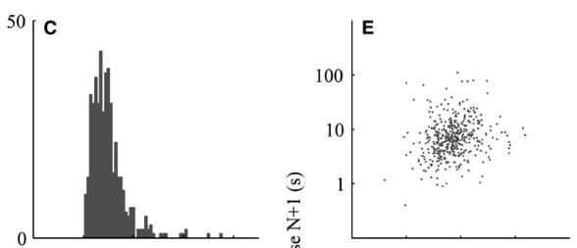
Percept to percept correlations
Percept duration
Percept N duration
++
Pressnitzer & Hupe, 2006

Slide 5
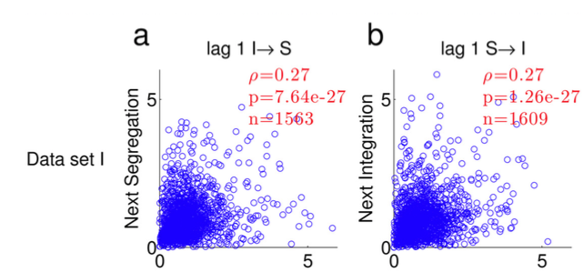
Percept to percept correlations
++
Barniv & Nelken, 2015

Slide 6
Percept to percept correlations
++

Slide 7
Percept to percept correlations
++

Slide 8
Percept to percept correlations
++

Slide 9
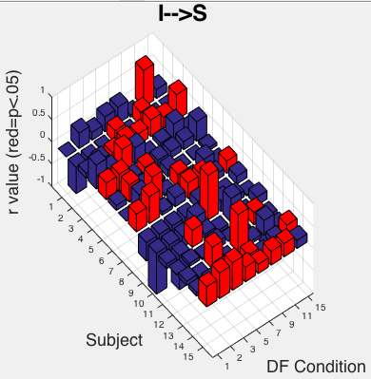
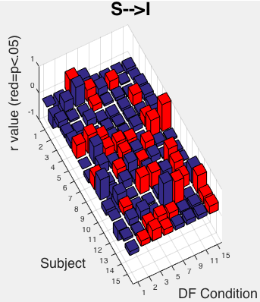
++

Slide 10
Cumulative history
?
state 2
state 1
?
?
state 2
state 1
time (s)
Does the duration of the next percept depend on previous history?
++

Slide 11
Introduction
Ambiguous auditory streaming stimulus
Small percept to percept correlations
What role does previous history play in dynamics of bistable perception? Does this elucidate neuronal mechanisms?
Statistical model
Neuronal simulations
Human subject data

Slide 12
Introduction
Statistical model
History function H(t; τ)
T (duration) vs H
Estimating parameters
Neuronal simulations
Human subject data

Slide 13
History function

Slide 14
History function
τ

Slide 15
History function
τ

Slide 16
History function
τ

Slide 17
The next percept duration is drawn from a distribution that depends on H(t)
H(t)
p(T|H(t)) =

Slide 18
The next percept duration is described by a family of gamma distributions for which the mean varies with H(t)
H(t)
p(T|H(t_{j})) =

Slide 19
Distribution means vary with H according to mx + B

Slide 20
Distribution means vary with H according to mx + B

Slide 21
Distribution means vary with H according to mx + B

Slide 22
Distributions vary with H according to LnT = mH + B

Slide 23
Cumulative history model parameters
k₁, k₂ – fixed shape parameter specifying gamma density joint distribution;
b₁, b₂ – log-mean at H_{x} = 0; “intercept”
m₁, m₂ – or alpha in p&B. Sensitivity to history; “slope”
τ - time scale of the history function
Data
History
Conditional Distribution
τ

Slide 24
Introduction
Statistical model
H(t; τ)
Duration drawn from one of a family of distributions for which mean is a function of H
Use MLE to find parameters
Neuronal simulations
Human subject data

Slide 25
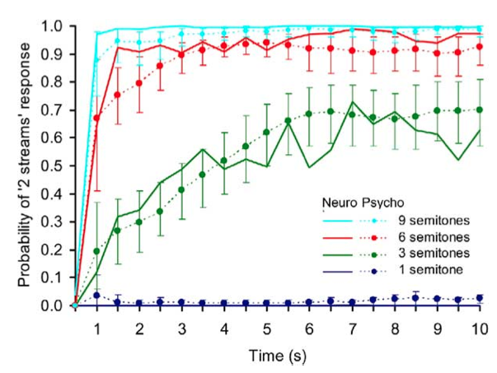
Buildup to stream segregation
++
Micheyl et. al. (2005)
human + monkey

Slide 26
Features of buildup
For long presentations, stimulus elicits perceptual alternations
First percept is (usually) always integration
(Weak) No first order correlations between subsequent percept durations
++

Slide 27
Alternating renewal process
++

Slide 28
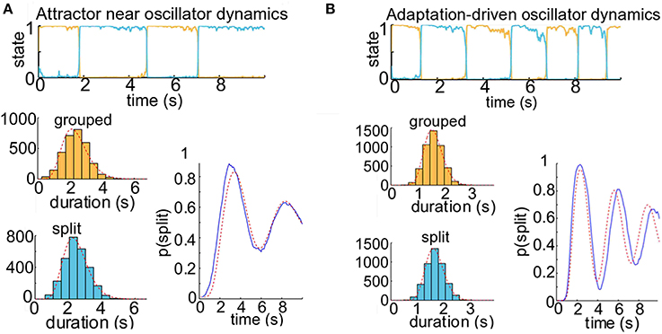
Alternative hypothesis: deviations observed with increasing adaptation
N>1000
++
r = .25
r = .3

Slide 29
Update: human data
15 participants, 3 blocks of 8 DF conditions, 4 minute trials
Stimuli – 125 msec tone durations, ABA_ with frequencies between 392 & 932 Hz
Minimum 30 – 120 sec between trials
Subjects performed 2AFC holding down one of 2 buttons to indicate percept
++
Rankin, Sussman & Rinzel, in review

Slide 30
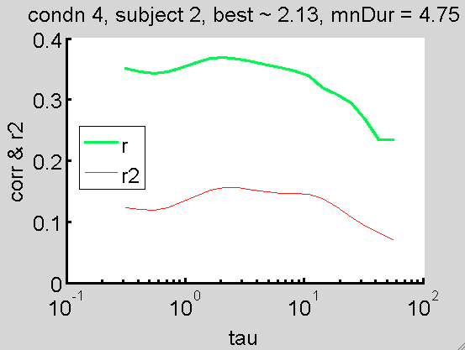
Analysis
++

Slide 31
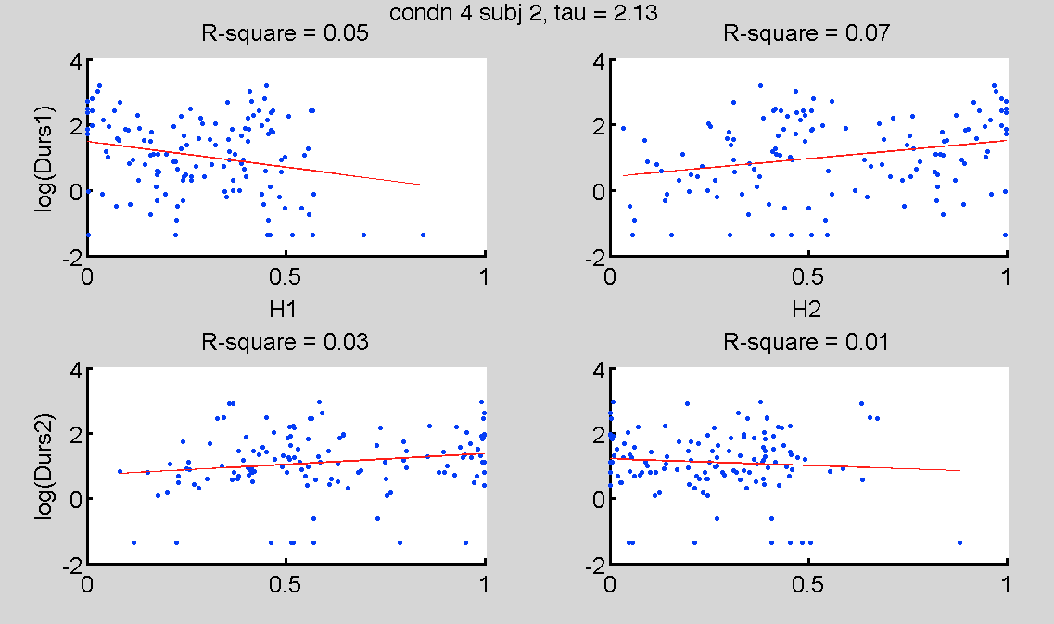
Analysis
++

Slide 32
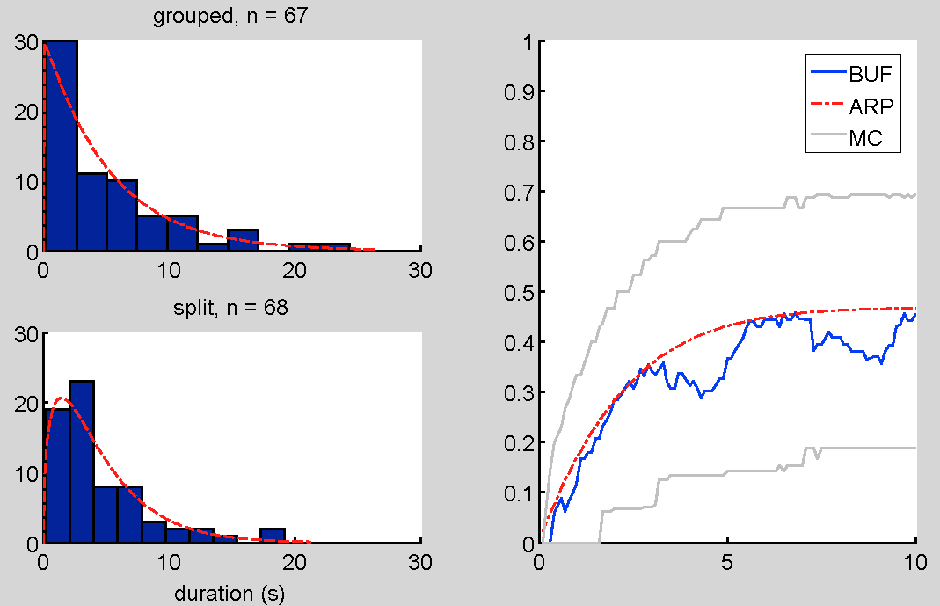
ARP provides good fit to psychophysical buildup functions
++

Slide 33
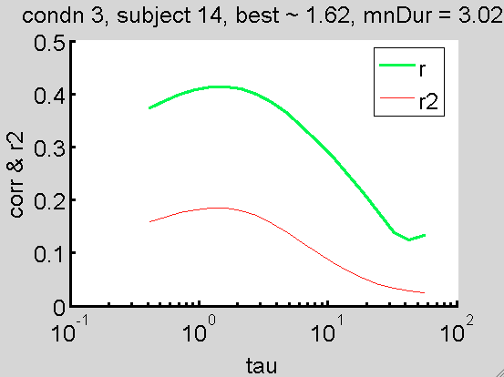
Analysis
++

Slide 34
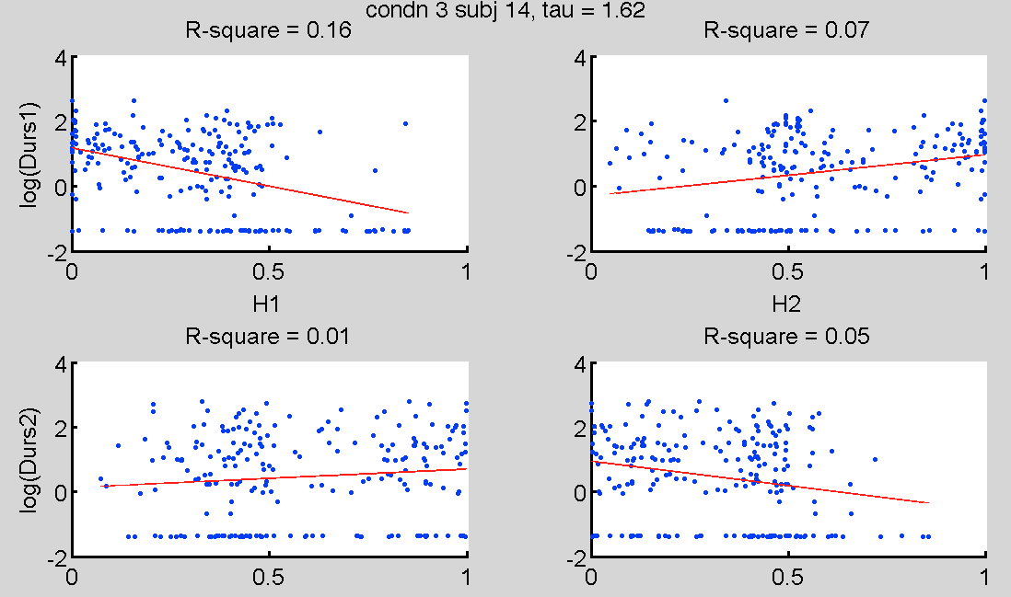
Analysis
++

Slide 35
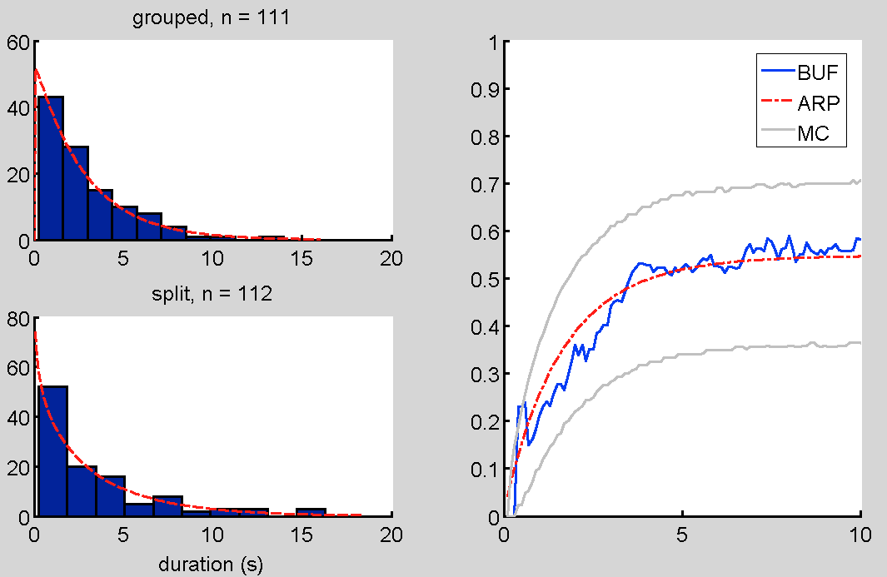
BUF
++

Slide 36
Further analysis
Use Monte Carlo simulations to generate data with significant history dependence and characterize deviations between BUF and ARP – how much data do we need?
Compute cumulative history measure in the data; novel application for ABA_ data
Combine data across subjects to get statistical power
++

Slide 37
Autoregressive generator
Ln(T) = a1 H1 + B + noise
++

Slide 38
Introduction
Statistical model
Neuronal simulations
How do neuronal parameters affect cumulative history?
What can cumulative history tell us about physiological processes?
Human subject data

Slide 39
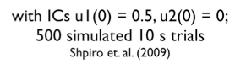
Competition model
Noisy input,
++

Slide 40
Competition models generate trial time courses
1299 samples
++

Slide 41
Fit model to simulated data with zero history dependence
K1 : 1.39
K2 : 1.34
B1 : 0.42
B2 : 0.60
M1 : 0.60
M2 : 0.05
Tau : 11.19
K1 : 1.38
K2 : 1.37
B1 : 0.69
B2 : 0.65
M1 : 0
M2 : 0
Tau : 1
(-4193 – (-4198)) = 2.495
Pval ~= .18
++

Slide 42
Oscillator: Ln(T) vs H
Parmhat:
k1 = 25.23
k2 = 31.57
b1 = .94
b2 = .95
m1 = -1.28
m2 = -1.27
Tau = 2.71
r = 0.35
fval (-LL) = 819

Slide 43
Competition Model- oscillator

Slide 44
Attractor (G=.3): ln(T) by H
Parmhat:
k1 = 5.64
k2 = 5.25
b1 = 1.06
b2 = 1.16
m1 = -.98
m2 = - 1.29
Tau = 2.24
fval (-LL) = 1169
Null:
k1 = 5.34
k2 = 4.83
b1 = .79
b2 = .80
m1 = 0
m2 = 0
Tau = “1”
fval (-LL) = 1202
2*(-1169-(-1202)) = 66 p~e-14

Slide 45
Attractor: histograms by H

Slide 46
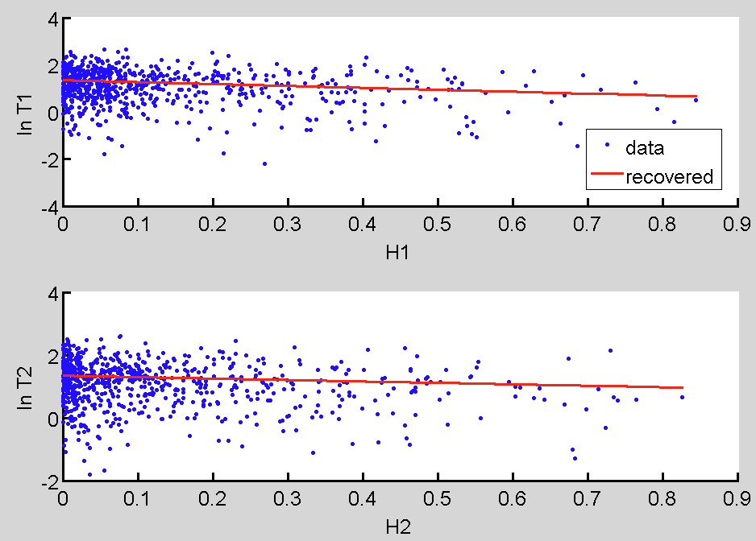
Attractor (G=.1): ln(T) by H
Parmhat:
k1 = 2.21
k2 = 2.49
b1 = 1.34
b2 = 1.34
m1 = -.81
m2 = - .45
Tau = 1.26
fval (-LL) =
2948
Null:
k1 = 2.24
k2 = 2.41
b1 = 1.27
b2 = 1.27
m1 = 0
m2 = 0
Tau = “1”
fval (-LL) = 2961
2*(-2961.4-(-2947.5)) = 66 p~1.9 e-6

Slide 47
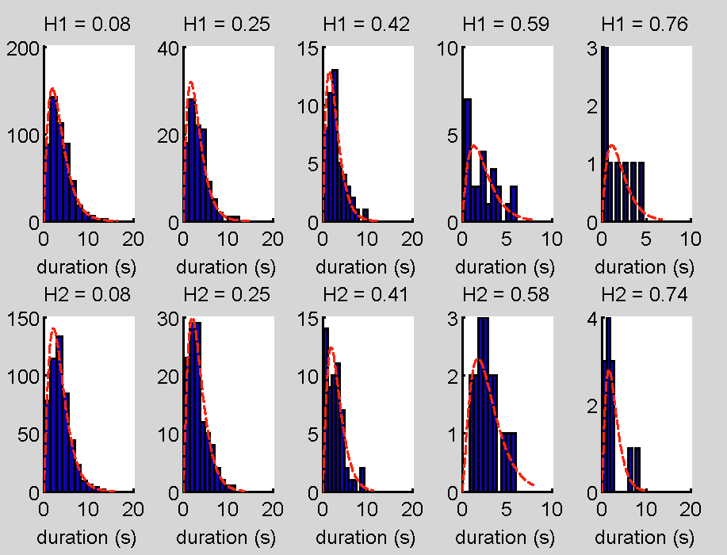
Attractor (G=.1): hists by H

Slide 48
Human data- 8 subjs, 4 min trials x5

Slide 51
Fitted model gives similar statistics

Slide 52
But there’s not a lot of consistency in the key parameters, tau & m

Slide 53
But there’s not a lot of consistency in the key parameters, tau & m

Slide 54
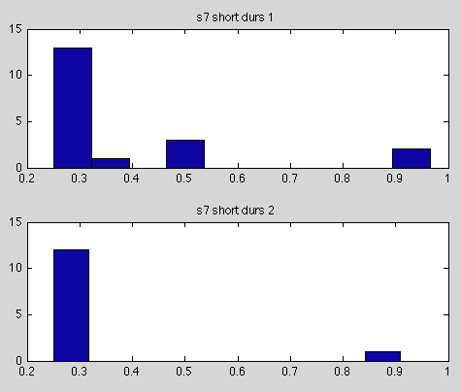
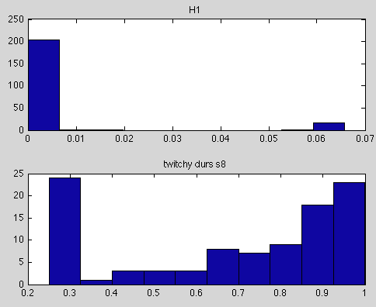
“twitchy” graphs

Slide 55
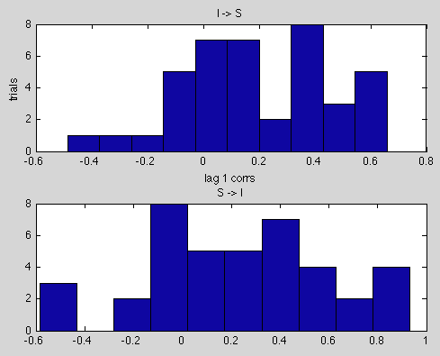
I-S and S-I corrs

Slide 56
To Do
Try normalization
Cross validation
Landscape analysis on pars

Slide 57
Acknowledgments
John Rinzel
Daniel Tranchina
Alex Reyes
Eero Simoncelli
Elyse Sussman
Amala Ankolekar-Hinge
Vik Keenan
Jason Mikiel-hunter
Josh Goldwyn
John D. Murray
Antje Ihlefeld
4th years

Slide 58
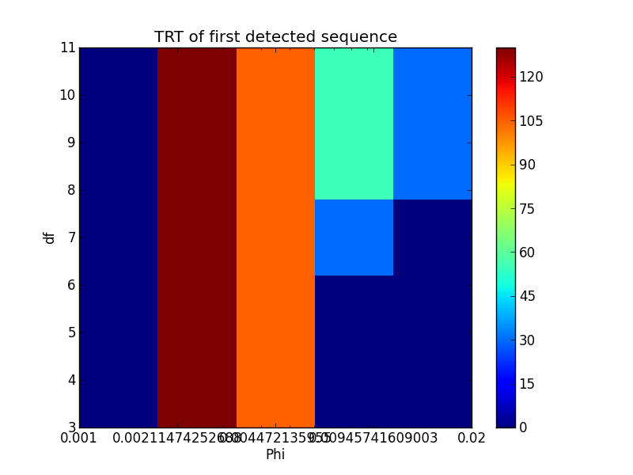
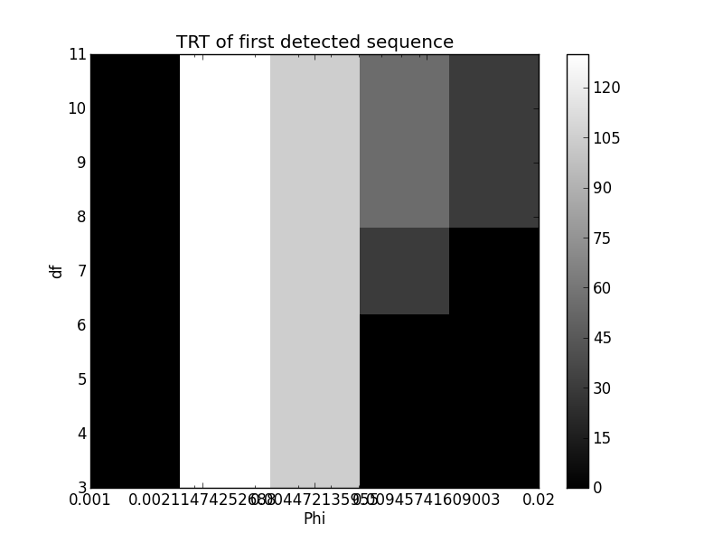
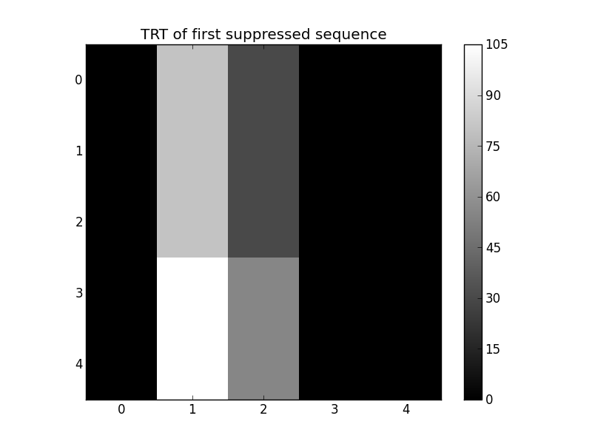
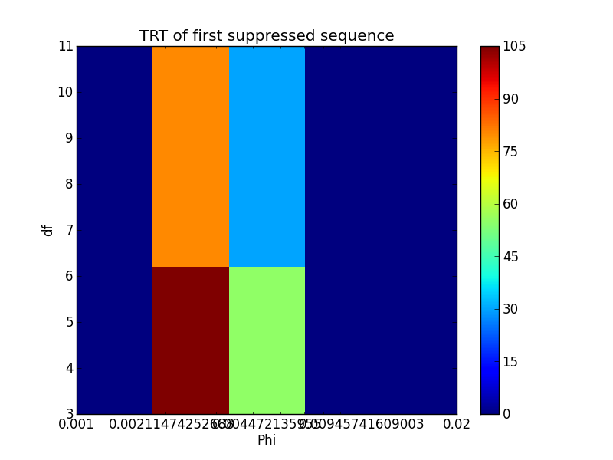
Parameter search

Slide 59
Analytical solution
++

